Slide 1


GroenGas – Sub-project I-AM
Integrated assessment and modelling
Partners
University of Oldenburg – Centre for Environment and Sustainability Research COAST
Thomas Klenke, Alexandra Pehlken
LEI Wageningen UR – Section Chain Performance
Michiel van Galen, Diti Oudendag

Slide 2
Presentation Outline
Aims
Two methods and approaches
  Sustainable Supply Chain Management – regional and transnational
  Performance analysis and benchmarking of biogas plant types
Sketches of preliminary results
We need you – How to integrate your results for the benefit of the whole GroenGas programme

Slide 3
Aims
I-AM develops, takes and supports actions to
integrate and synthesise results of the individual sub-projects
assess innovations and improvements along the GroenGas supply chain
implement powerful GroenGas options

Slide 4
Methods and Approaches
Sustainable Supply Chain Management
SSCM
Generic approach to analyse framework, targets, actors, enablers and performance indicators of regional or transnational bioenergy supply chains
SSCManager
Software tool to analyse biogas supply chains and to rank options according to stakeholders´ preferences and aims

Slide 5
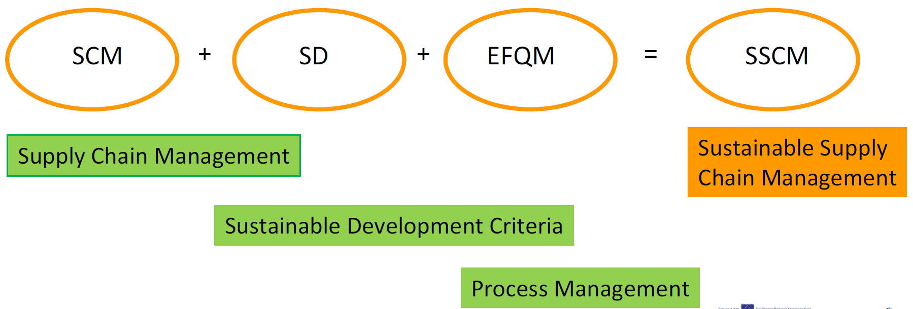
Methods and Approaches
Sustainable Supply Chain Management

Slide 6
Methods and Approaches
Sustainable Supply Chain Management
Process stage 1
Materials supply
Process stage 2
Logistics
Process stage 3
Usage
Process stage 5
Process stage 4
Conversion biomass to energy
Grid and distribution

Slide 7
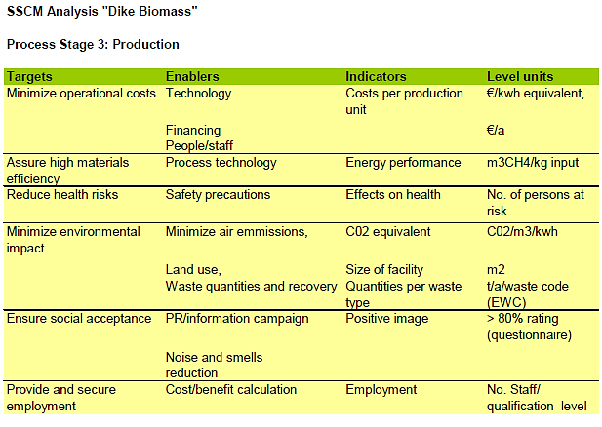
Methods and Approaches
Sustainable Supply Chain Management

Slide 8
Methods and Approaches
Performance Analysis and Benchmarking
GazMo (previous Bio BEM)
Goal
  support economic viability of individual ventures; existing and new ones
  in relation with Groen Gas: assessment of expected individual pilots and of the project as a whole

Slide 9
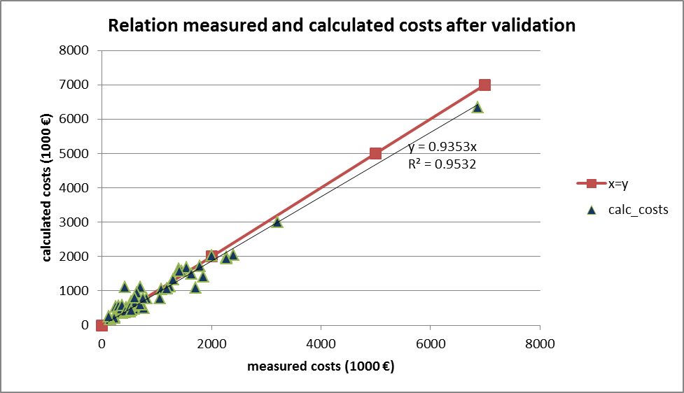
Sketches of preliminary results
Performance Analysis and Benchmarking
GazMo (previous Bio BEM)
October 2013:
  For now, gas converted to heat and/or electricity in the model
  Model validated with Dutch 2011 data on ~100 fermenters
inputs
Pre-treatments
fermenter
Post-treatments
outputs

Slide 10
How to integrate your results
GazMo development 2014:
  modelling green gas production (besides heat and electricity)
  webversion of the model
  benchmark other green gas projects including Interreg projects
Performance Analysis and Benchmarking

Slide 11
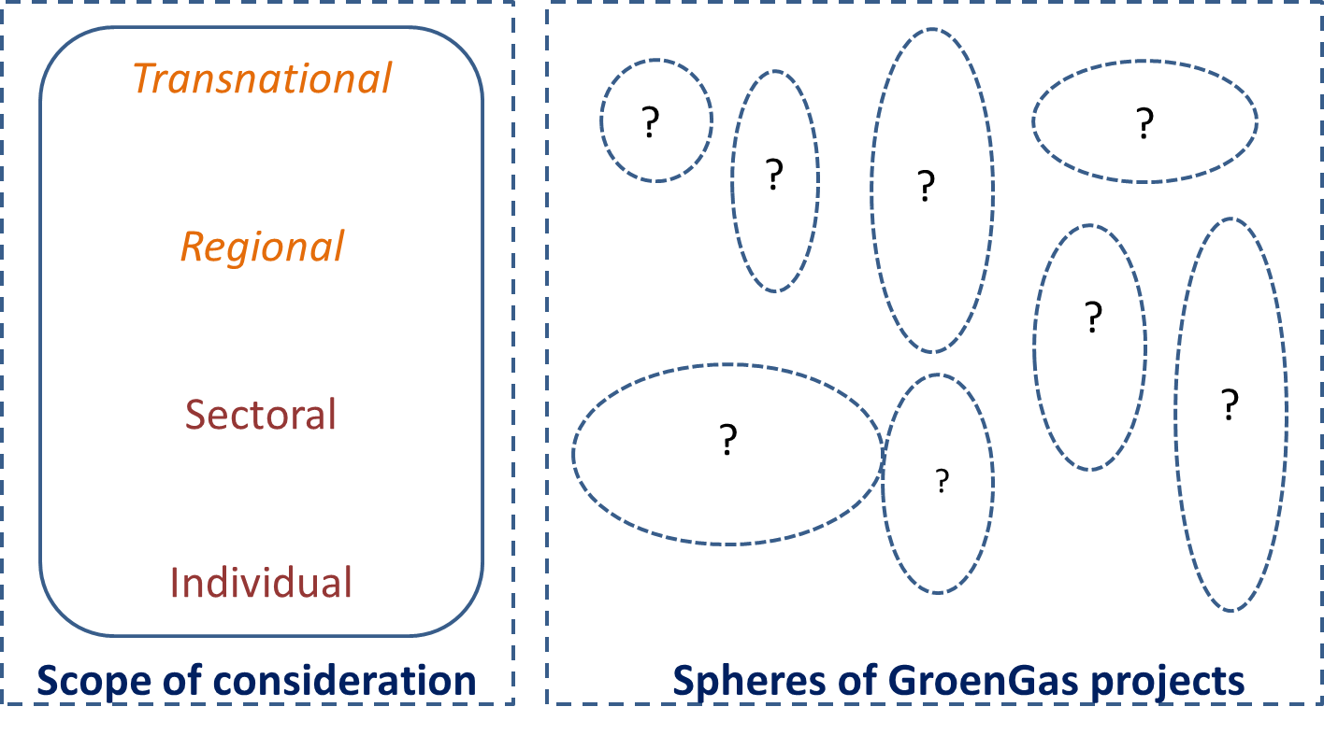
How to integrate your results
Process stage 1
Mate-rials supply
Process stage 2
Logistics
Process stage 3
Usage
Process stage 5
Process stage 4
Con-version biomass to energy
Grid and distribu-tion

Slide 12

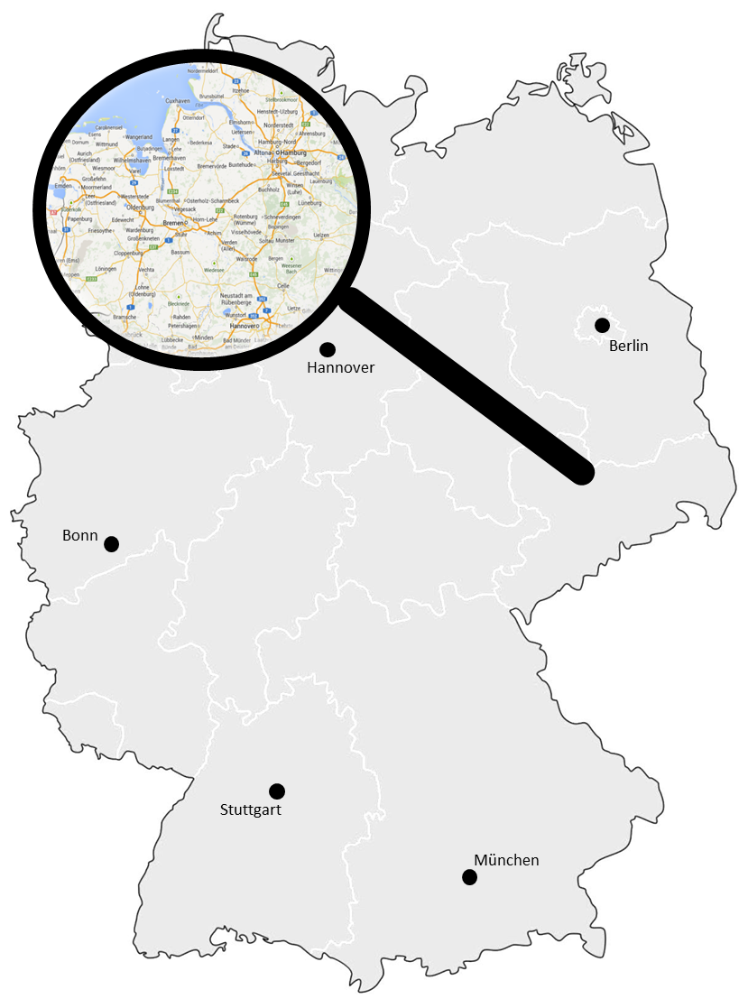
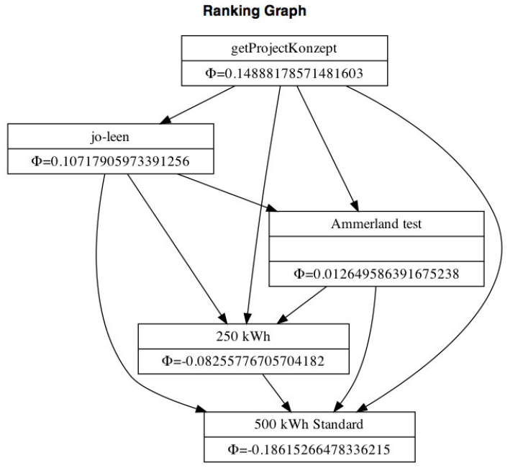
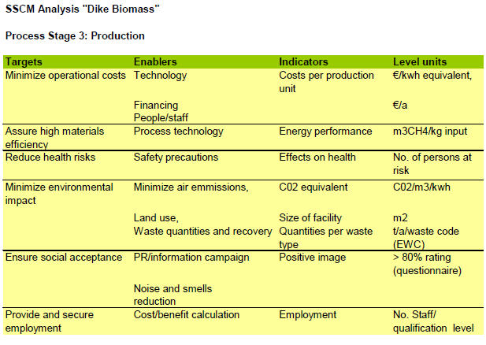
How to integrate your results
DELaND case studies

Slide 13
How to integrate your results
Your information needed as food for thought and fuel for the overall assessment:
achieved aims of your project
localities and involved stakeholders
numbers/data in relation to the process stages of the supply chain, in particular
  – performance of different types of biogas plants
  – biomass (producers, availability, energy content)
  – usage (consumers, modes, prices and return on investment)
barriers to implement innovations

Slide 14



Thank you for your attention.
Questions,
Suggestions,
Criticism?

